Slide 1

Hadoop and HBase
Nahidul Islam-2028
Md. Shakil Hossain-2023
Mahbubur Rahman-2024
Rahul das – 2026

Slide 2
Hadoop

Slide 3
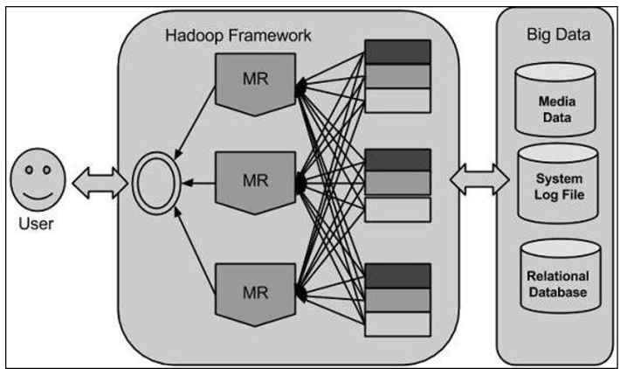
Introduction
Hadoop is an open source software programming framework for storing a large amount of data and performing the computation. Its framework is based on Java programming with some native code in C and shell scripts.
It is designed to handle big data and is based on the MapReduce programming model, which allows for the parallel processing of large datasets.

Slide 4
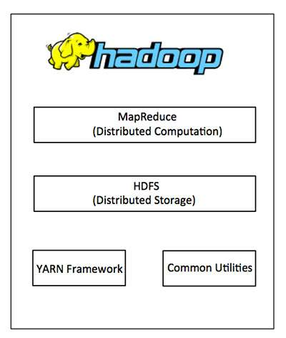
Hadoop Architecture
At its core, Hadoop has two major layers namely:
Processing/Computation layer (MapReduce)
Storage layer (Hadoop Distributed File System).

Slide 5
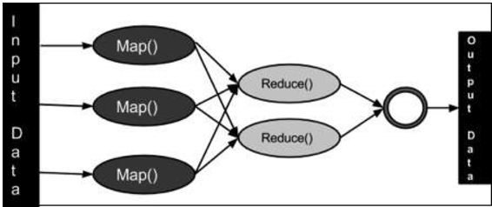
MapReduce
This is the processing layer of Hadoop. It's a programming model for processing large datasets in parallel. The process involves two main phases:
Map: The input data is divided into smaller chunks, and a user-defined map function processes each chunk, producing key-value pairs.
Reduce: The output from the map phase is grouped by key, and a user-defined reduce function processes the values associated with each key, producing the final output.

Slide 6
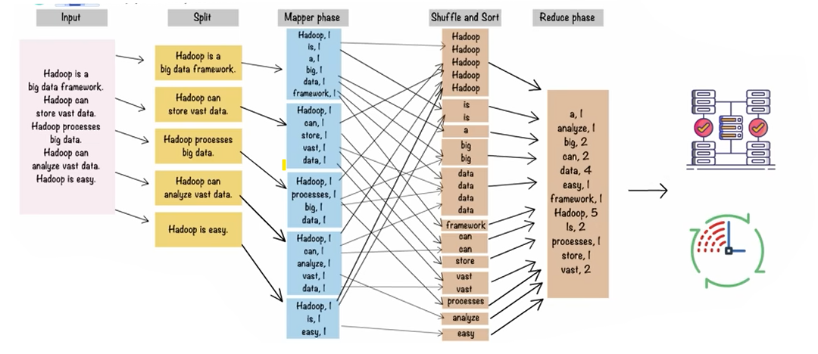
MapReduce

Slide 7
Hadoop Distributed File System (HDFS)
This is the storage layer of Hadoop. It's designed for storing large files across multiple machines. HDFS breaks files into smaller blocks (typically 64MB or 128MB) and distributes these blocks across the cluster. This allows for parallel processing and fault tolerance. Key features include:
Data replication: Blocks are replicated across multiple nodes for fault tolerance. If one node fails, the data can be retrieved from another.
Write-once-read-many access: Files are typically written once and then read many times. This model simplifies data consistency.
NameNode: Manages the file system metadata, including the location of blocks.
DataNodes: Store the actual data blocks.

Slide 8
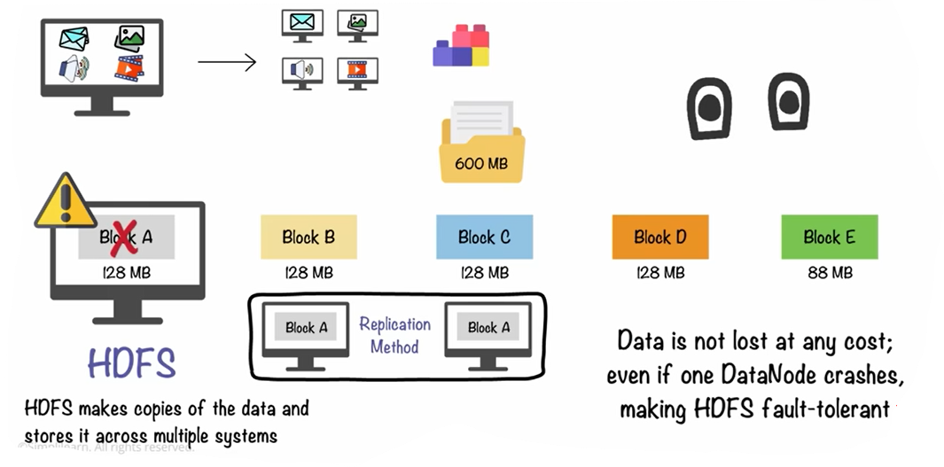
Continue…

Slide 9
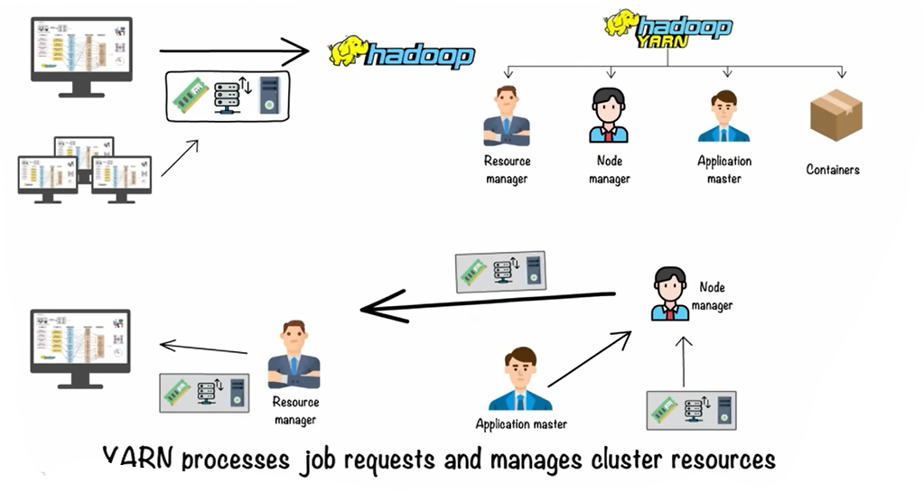
Yarn (Yet Another Resource Negotiator)
A cluster resource management system responsible for scheduling and managing resources (CPU, memory, network) for running applications on Hadoop. It allows for running various processing frameworks besides MapReduce, such as Spark.

Slide 10
Some common frameworks of Hadoop
Hive- It uses HiveQL for data structuring and for writing complicated MapReduce in HDFS.
Drill- It consists of user-defined functions and is used for data exploration.
Storm- It allows real-time processing and streaming of data.
Spark- It contains a Machine Learning Library(MLlib) for providing enhanced machine learning and is widely used for data processing. It also supports Java, Python, and Scala.
Pig- It has Pig Latin, a SQL-Like language and performs data transformation of unstructured data.
Tez- It reduces the complexities of Hive and Pig and helps in the running of their codes faster.

Slide 11
Use Cases
Log processing and analysis: Analyzing website logs, application logs, and security logs.
Data warehousing: Storing and analyzing large datasets for business intelligence.
Recommendation systems: Building personalized recommendation engines.
Fraud detection: Identifying fraudulent transactions.
Image processing: Processing and analyzing large image datasets.
Scientific research: Analyzing large scientific datasets, such as genomic data

Slide 12
Key Features and Benefits of Hadoop
Scalability: Hadoop can easily scale horizontally by adding more nodes to the cluster. This allows it to handle ever-increasing amounts of data.
Fault Tolerance: Data replication and automatic failover mechanisms ensure that the system can continue operating even if individual nodes fail.
Cost-Effectiveness: Hadoop can run on commodity hardware, making it a more affordable solution compared to traditional enterprise storage systems.
Flexibility: Hadoop can handle a variety of data formats, including structured, semi-structured, and unstructured data.
Data Locality: Computation is moved to the data, minimizing data transfer and improving performance.

Slide 13
Disadvantages
Not very effective for small data.
Hard cluster management.
Has stability issues.
Security concerns.
Complexity: Hadoop can be complex to set up and maintain, especially for organizations without a dedicated team of experts.
Latency: Hadoop is not well-suited for low-latency workloads and may not be the best choice for real-time data processing.
Limited Support for Real-time Processing: Hadoop’s batch-oriented nature makes it less suited for real-time streaming or interactive data processing use cases.

Slide 14
HBase

Slide 15
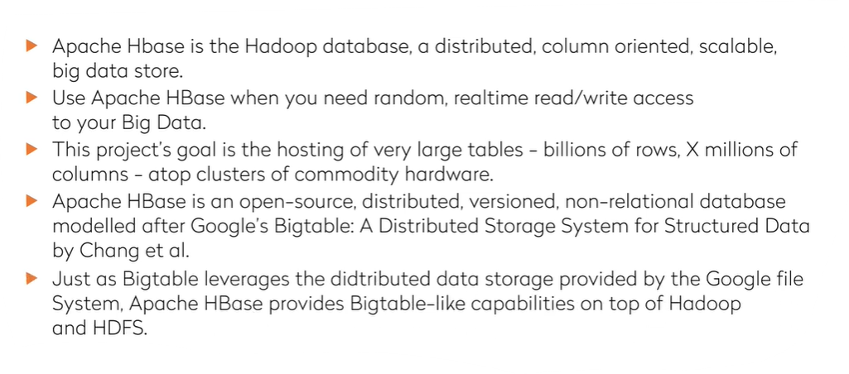
Introduction

Slide 16
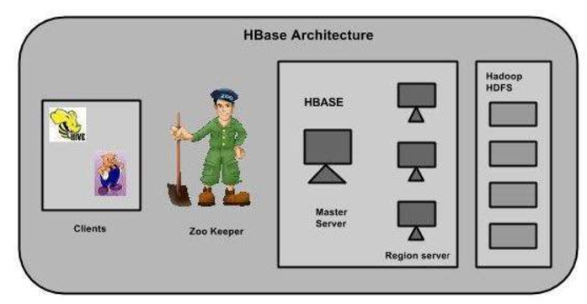
HBase Architecture
In HBase, tables are split into regions and are served by the region servers. Regions are vertically divided by column families into “Stores”. Stores are saved as files in HDFS
HBase has three major components: the client library, a master server, and region servers. Region servers can be added or removed as per requirement.

Slide 17
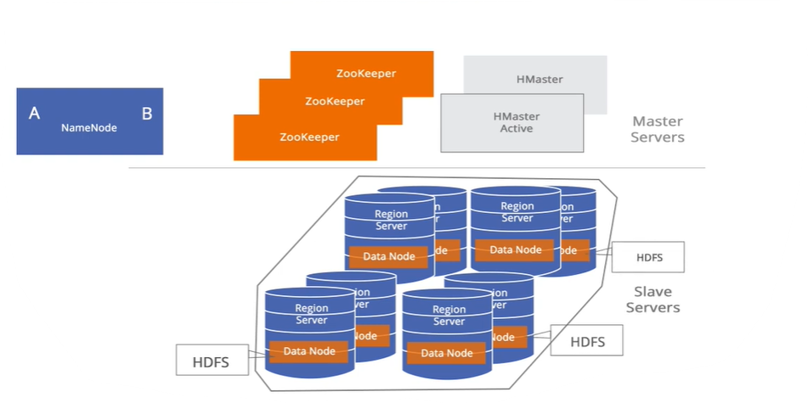
Continue…

Slide 18
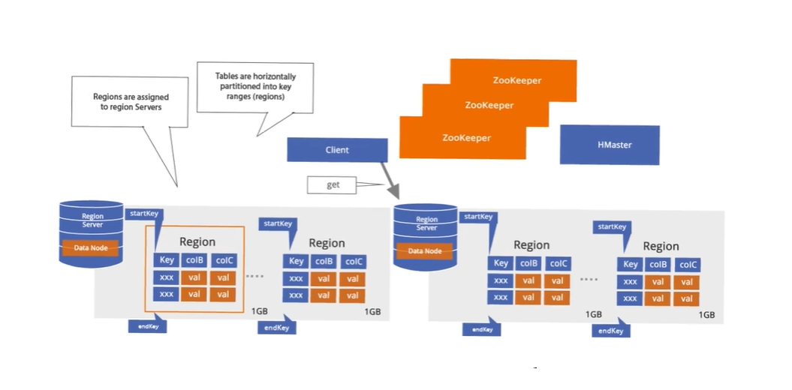
Continue…

Slide 19
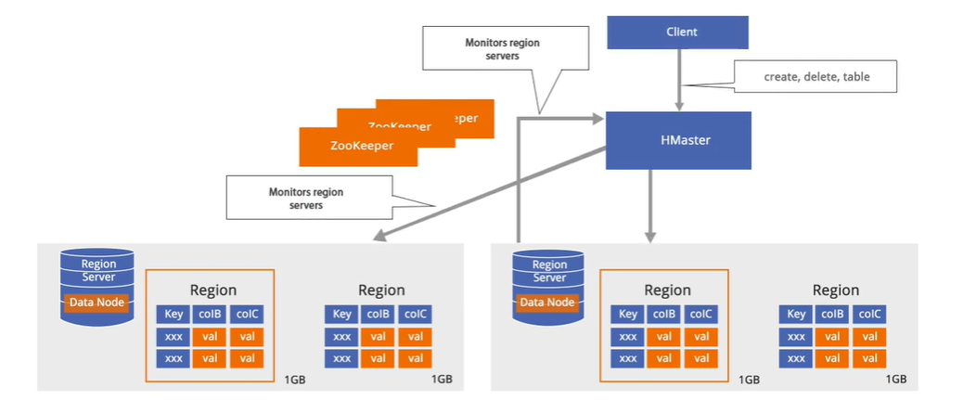
Master Server
Assigns regions to the region servers and takes the help of Apache ZooKeeper for this task.
Handles load balancing of the regions across region servers. It unloads the busy servers and shifts the regions to less occupied servers.
Maintains the state of the cluster by negotiating the load balancing.
Is responsible for schema changes and other metadata operations such as creation of tables and column families.

Slide 20
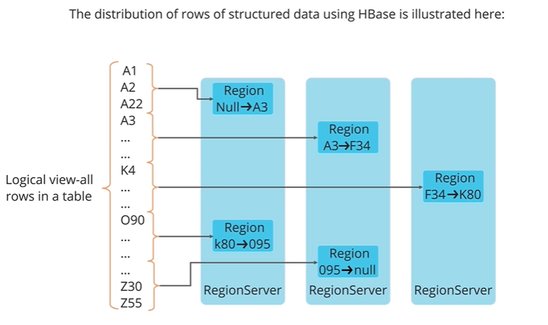
Regions
Communicate with the client and handle data-related operations.
Handle read and write requests for all the regions under it.
Decide the size of the region by following the region size thresholds.
The store contains memory store and HFiles. Memstore is just like a cache memory. Anything that is entered into the HBase is stored here initially. Later, the data is transferred and saved in HFiles as blocks and the memstore is flushed.

Slide 21
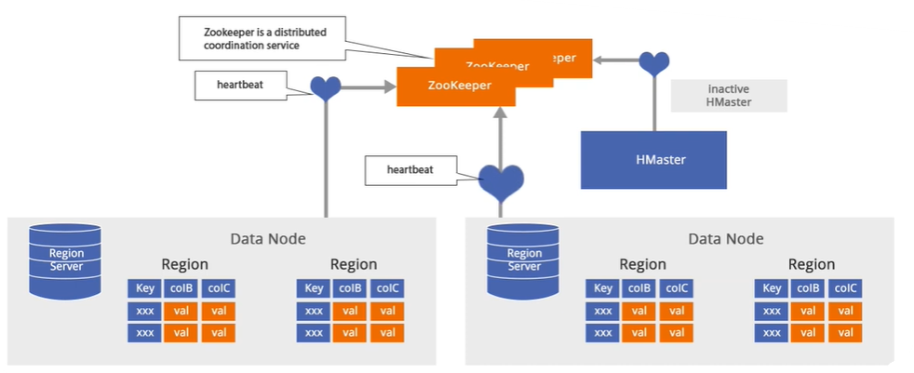
Zookeeper
Zookeeper is an open-source project that provides services like maintaining configuration information, naming, providing distributed synchronization, etc.
Zookeeper has ephemeral nodes representing different region servers. Master servers use these nodes to discover available servers.
In addition to availability, the nodes are also used to track server failures or network partitions.
Clients communicate with region servers via zookeeper.
In pseudo and standalone modes, HBase itself will take care of zookeeper.

Slide 22
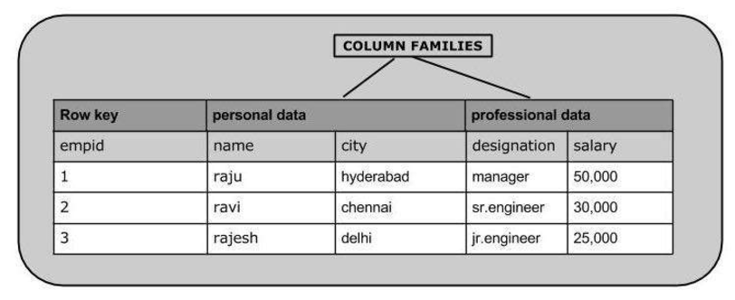
Data Model
Table: A collection of related data organized into rows and columns.
Row: Identified by a unique row key. Rows are sorted lexicographically by row key.
Column Family: A group of related columns. Column families must be defined when creating a table. They are stored together on disk.
Column Qualifier: Identifies a specific column within a column family.
Cell: The intersection of a row, column family, and column qualifier. Contains a timestamped value

Slide 23
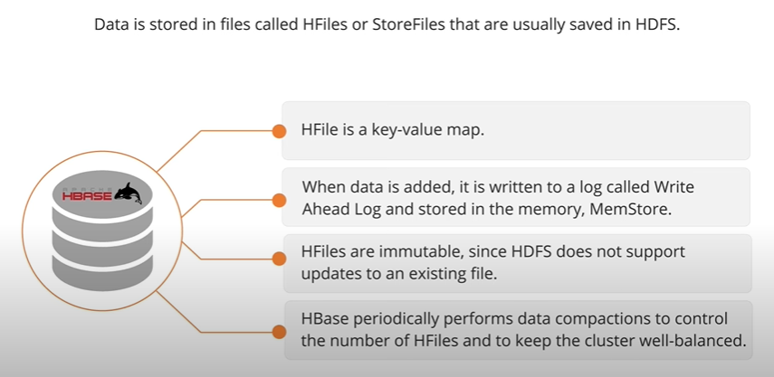
Data Storage in HBase

Slide 24
Key Features
Column-oriented: Data is stored in column families rather than rows. This allows for efficient retrieval of specific columns without reading the entire row, which is particularly useful when dealing with wide tables with many columns.
Scalable: HBase can handle massive datasets by distributing data across a cluster of machines. It leverages HDFS for its underlying storage, inheriting its scalability and fault tolerance.
Real-time access: HBase is designed for low-latency read and write operations, making it suitable for real-time applications.
Consistent reads and writes: HBase offers strong consistency for individual rows. All changes to a row are atomic and immediately visible.
Fault-tolerant: HBase is built on top of HDFS, which provides data replication and automatic failover, ensuring high availability.
Simple data model: Data is represented as key-value pairs, where the key identifies a row and the value is a collection of columns organized into column families.

Slide 25
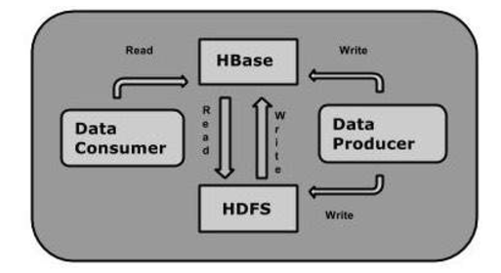
Relationship between HBase, HDFS
Data Producers: These are applications or processes that generate and write data. Examples include web servers logging user activity, sensors collecting data, or applications generating transactional data. The arrow indicates that data producers write data to HBase.
HBase: This is the NoSQL database that acts as a layer on top of HDFS. It receives data from producers and stores it in a structured manner within HDFS. HBase also serves data to consumers.
HDFS (Hadoop Distributed File System): This is the underlying storage layer where the actual data resides. HBase utilizes HDFS to store its data files. The diagram shows bidirectional communication between HBase and HDFS, indicating both read and write operations. HBase writes data to HDFS for persistent storage and reads data from HDFS to serve requests from consumers.
Data Consumers: These are applications or processes that read and utilize the data stored in HBase. Examples include analytics tools, reporting dashboards, or applications that require access to specific data points. The arrow indicates that data consumers read data from HBase.

Slide 26
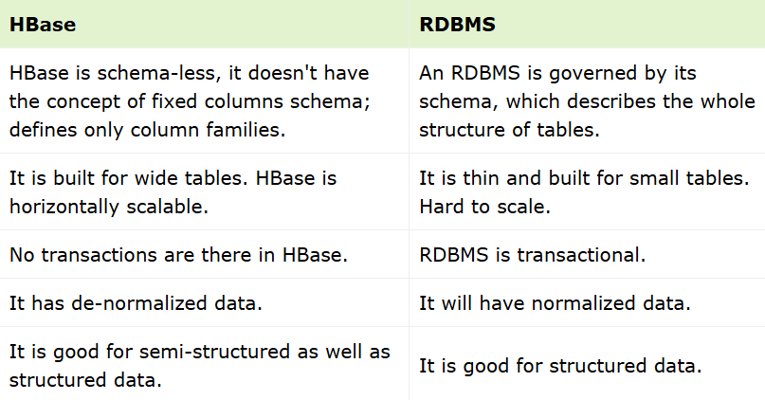
HBase and RDBMS

Slide 27
Use Cases
Apache HBase is used to have random, real-time read/write access to Big Data.
It hosts very large tables on top of clusters of commodity hardware.
Apache HBase is a non-relational database modeled after Google's Bigtable. Bigtable acts up on Google File System, likewise Apache HBase works on top of Hadoop and HDFS.
It is used whenever there is a need to write heavy applications.
HBase is used whenever we need to provide fast random access to available data.
Companies such as Facebook, Twitter, Yahoo, and Adobe use HBase internally.

Slide 28
Thank You

